Slide 1
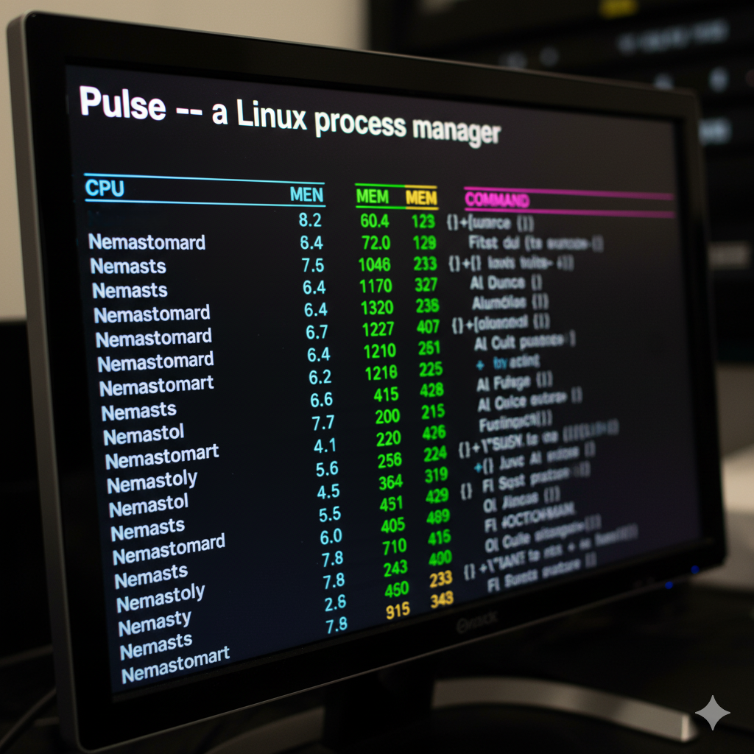
Pulse: A Linux Process Manager
Presentation by:
Sajib Sarkar
Roll No. 1616
Software Project Lab-1

Slide 2
The Cons of Current Options
Our Approach
Traditional tools like top, htop flood users with fragmented, raw metrics.
These unreadable metrics make identifying the core happening tough for users
Pulse introduces user-friendly metrics that are easy to follow
Our process aggregation combines thousand of process data into the boundaries of apps.

Slide 3
Core Features: The Pulse Ecosystem
Non-Intrusive Extraction
Efficient Calculation
Aggregation into Apps
Directly reads from the /proc filesystem, minimizing system overhead and avoiding kernel module dependencies.
Utilizes a sliding window approach for CPU metrics, providing precise, real-time performance insights.
Groups related processes using a sophisticated tree-based algorithm for clear application context.
Safe Control
Grouping by Usage
Leverages POSIX signal dispatching for robust and secure process management actions, like kill, suspend, etc.
Groups applications by their usage by implementing clustering algorithm (k-medoids) to provide insights

Slide 4
Technologies Used
Language : C
Compiler : GNU GCC compiler
OS : Linux
Libraries : stdio, stdlib, signal, etc.

Slide 5
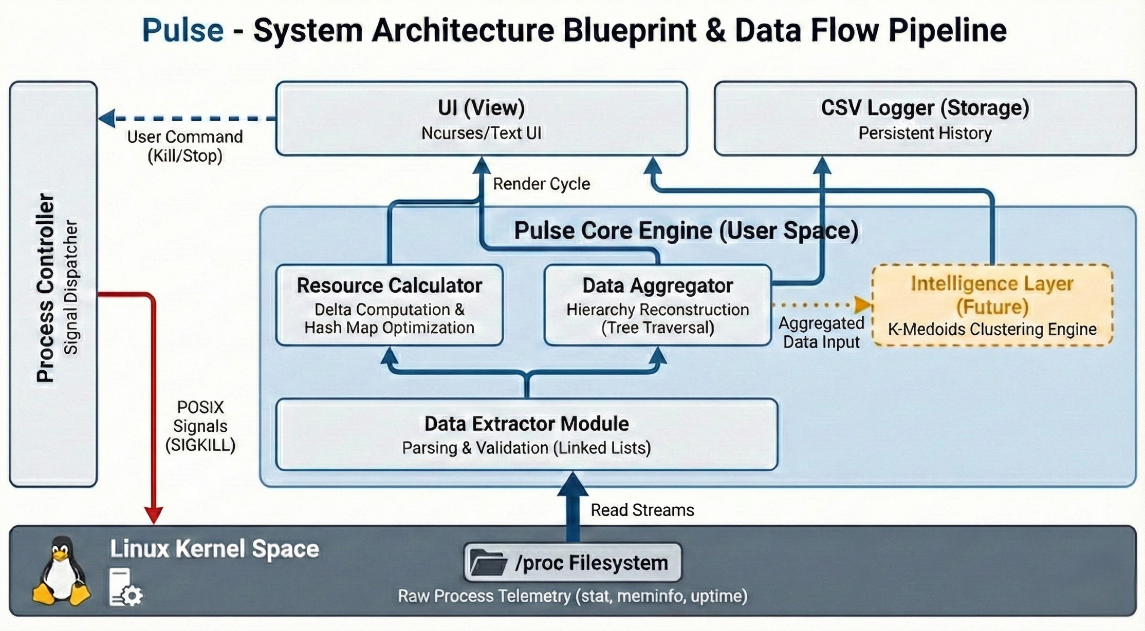

System Architecture: The Pulse Pipeline
Pulse is built upon a robust, modular architecture designed for efficiency and scalability. It meticulously separates data collection from presentation, ensuring low overhead and high responsiveness.
This modularity allows for independent optimization of each stage, providing a flexible and powerful monitoring solution.

Slide 6
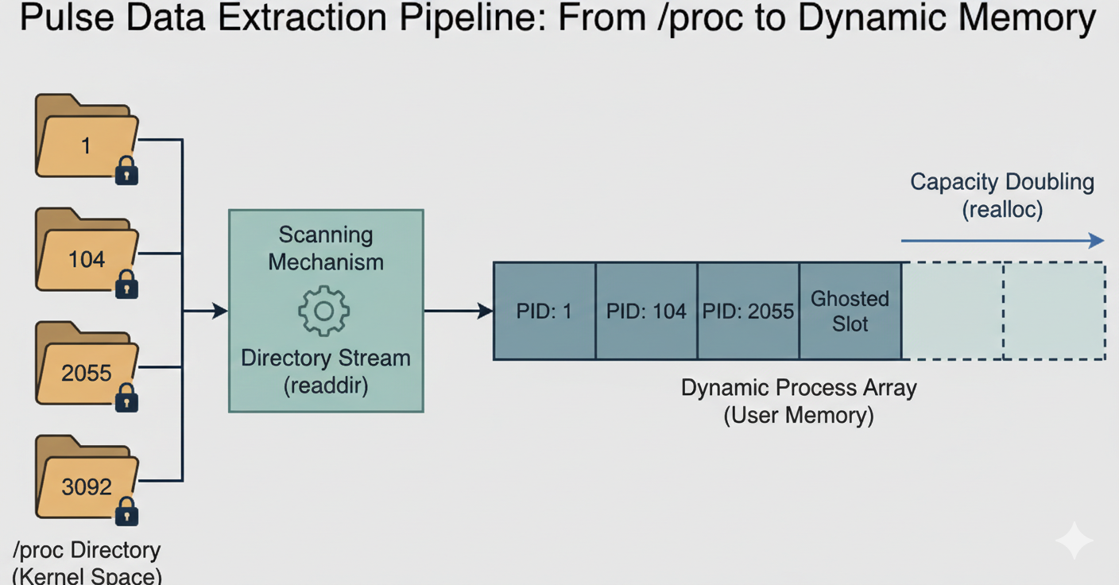

Slide 7
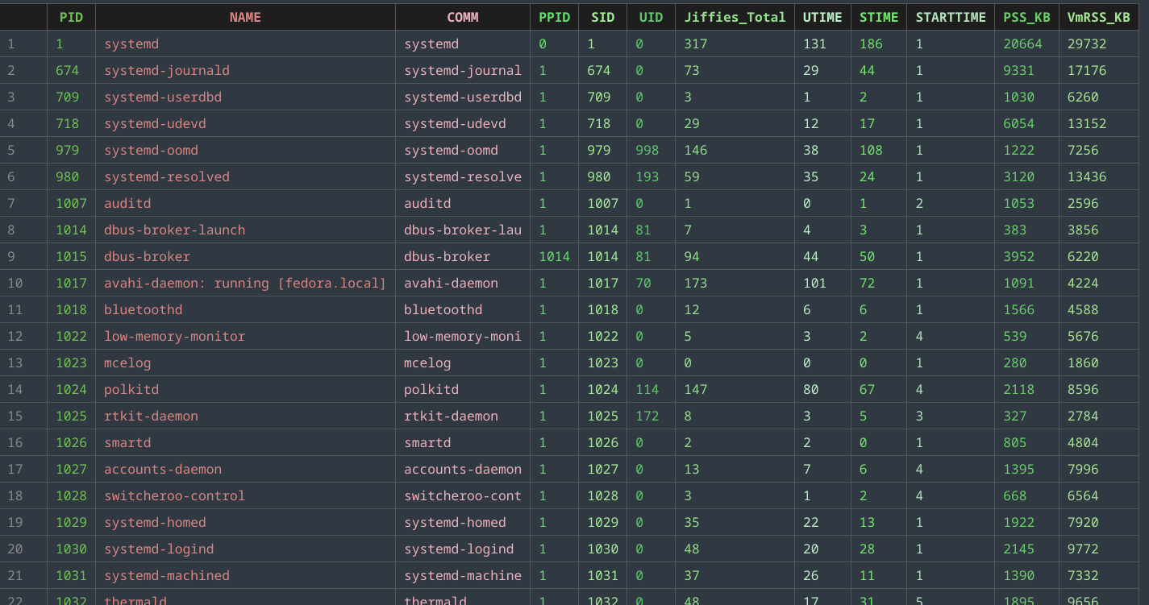
Deep Dive: Data Extraction
Mechanism: Direct readdir traversal of /proc directories (No syscall overhead).
Optimization: Dynamic Arrays (Vectors) ensure contiguous, cache-friendly memory.
Safety: Proactive filtering of kernel threads and locked folders prevents crashes

Slide 8
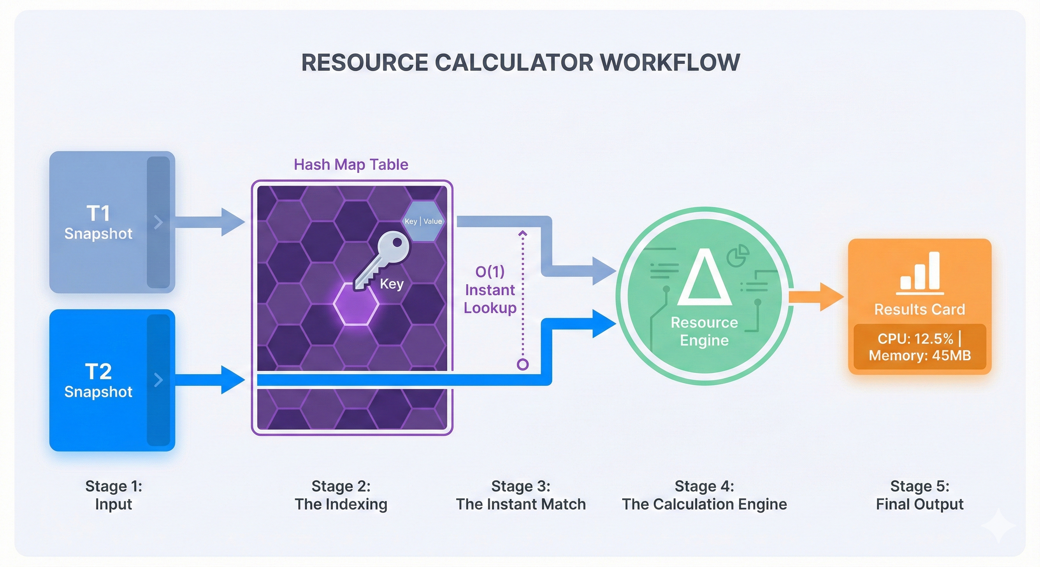

Slide 9
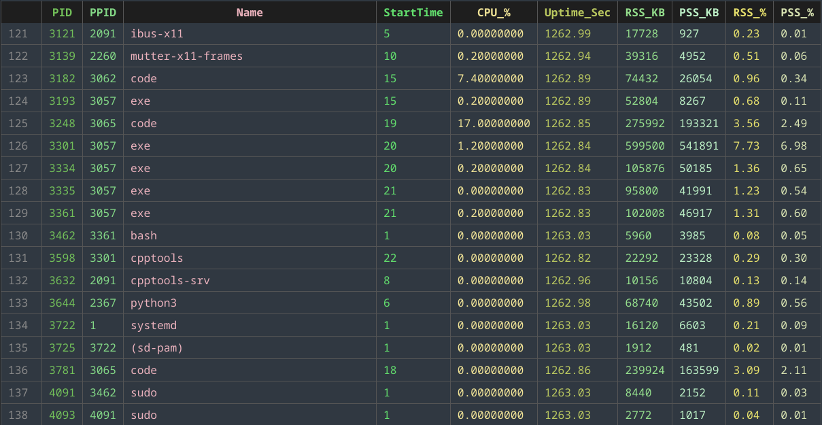
Deep Dive: Resource Calculation
The Challenge: Naive snapshot comparison scales poorly (O(N²)), causing UI freeze.
The Solution: Custom Hash Map implementation for instant PID matching.
The Result: Achieves O(1) average complexity for real-time CPU delta calculation.

Slide 10
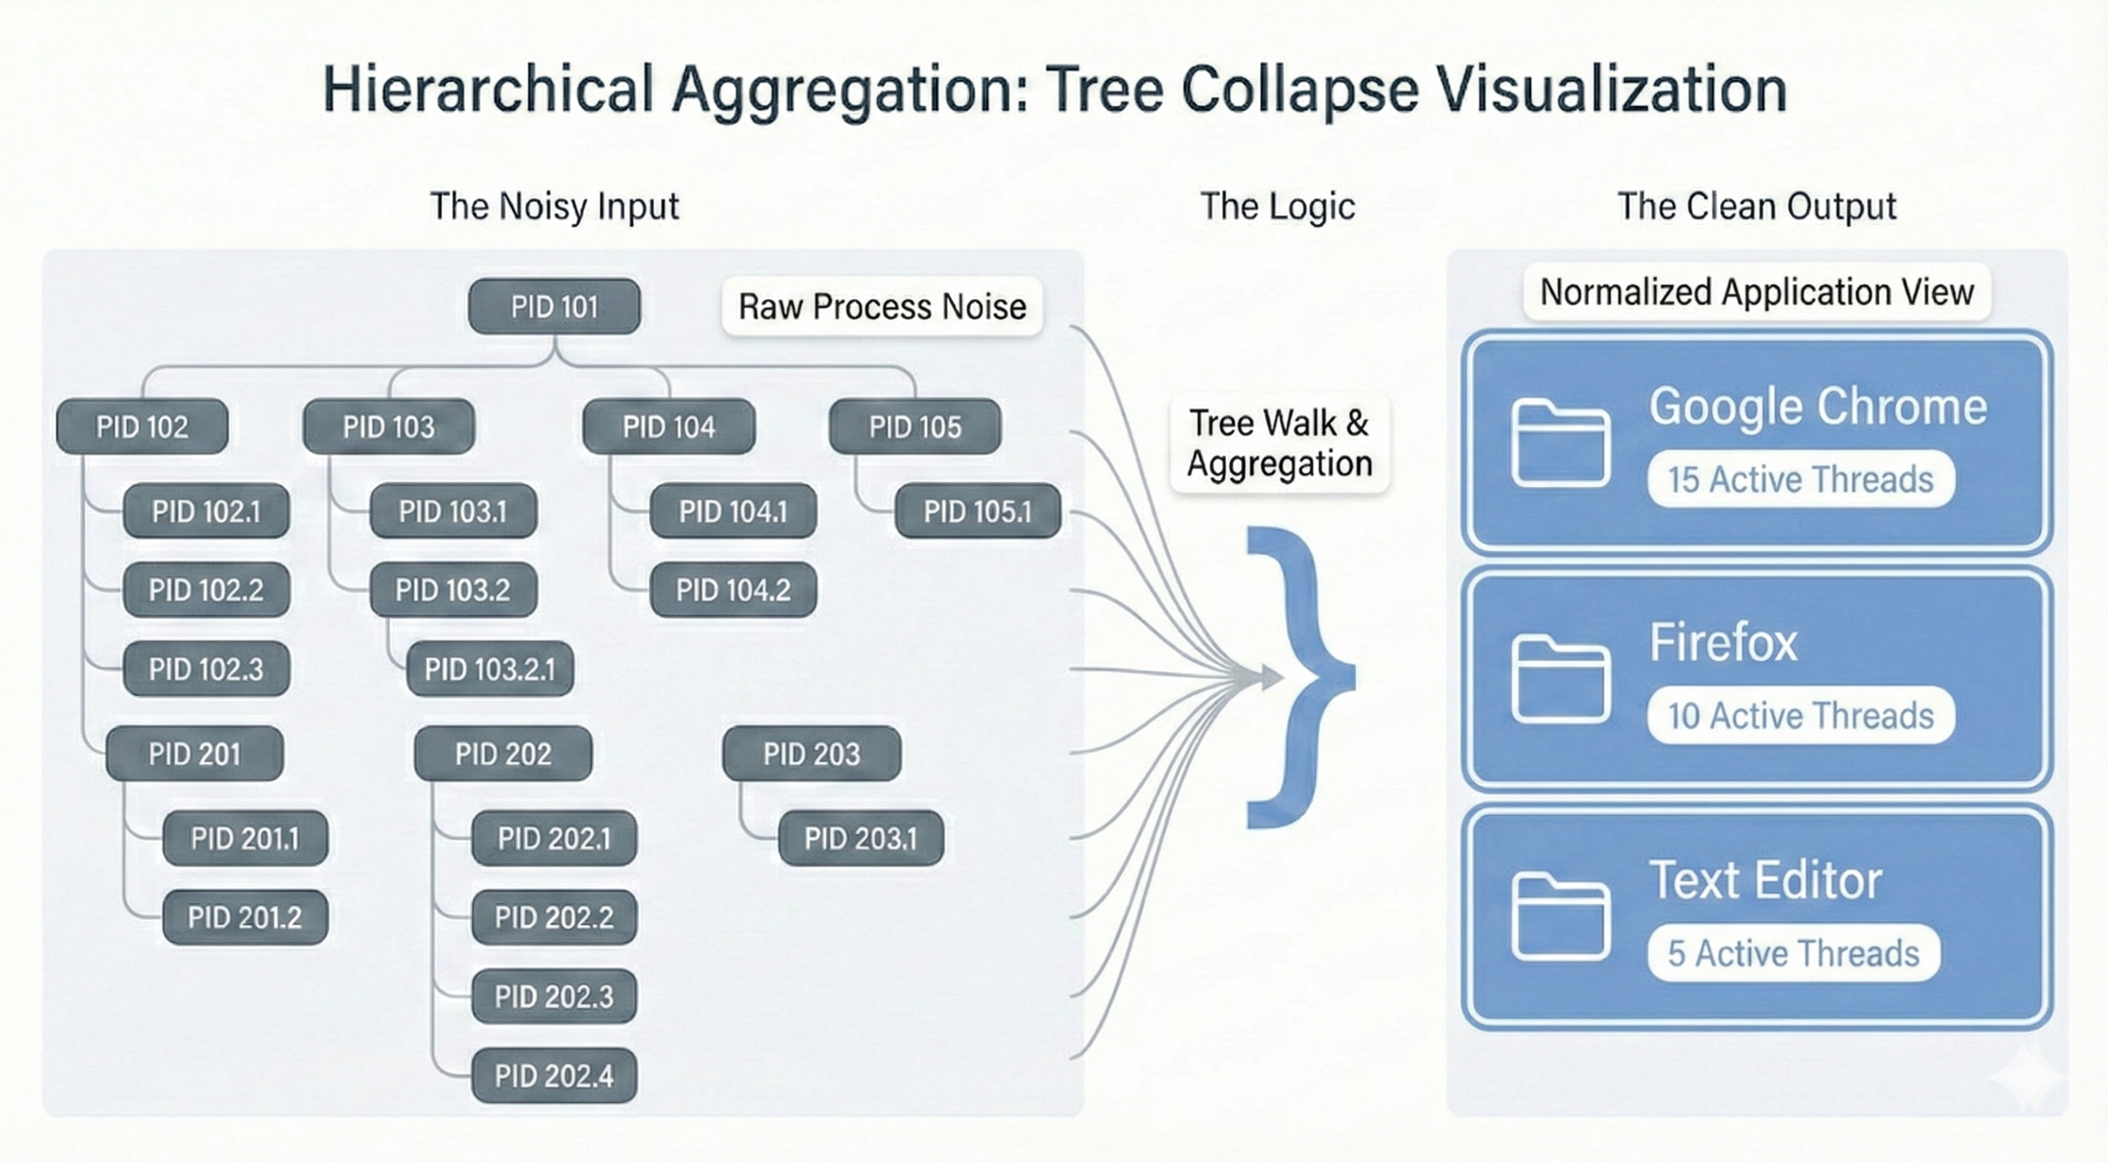

Slide 11
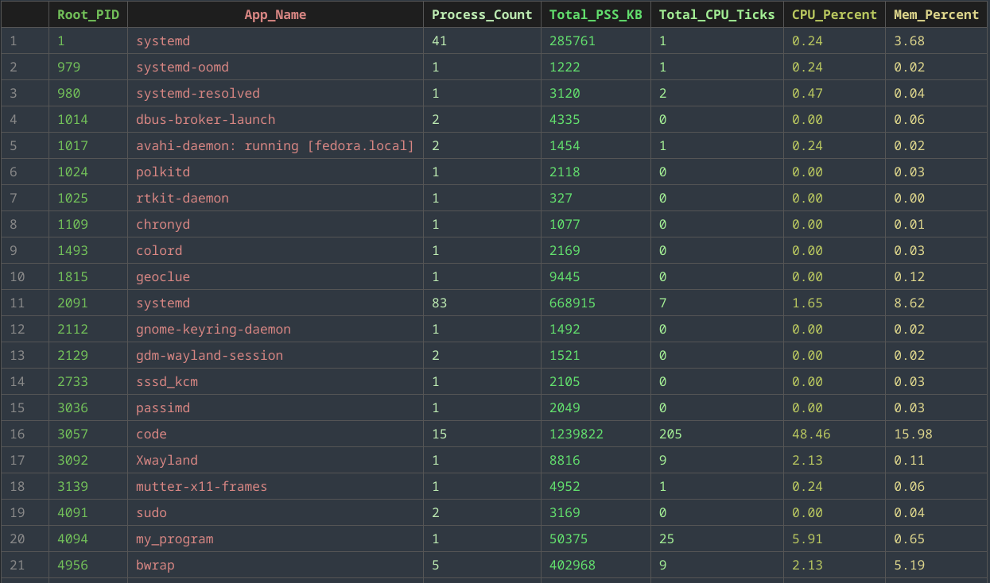
Process Aggregation
Logic: "Tree Walk" algorithm recursively traces every PID to its root parent.
Heuristics: Smart detection of boundaries (e.g., Shells, User IDs) defines the app.
Outcome: Transforms scattered kernel threads into unified "Application Units".

Slide 12
Future Roadmap
Implement System Control
Using POSIX commands like SIGKILL, implement process control functions like kill, suspend and change priority
Apply Clustering Algorithm
Use clustering algorithm to group processes by resource usage.
UI Design
Create a presentable user interface that is intuitive and user-friendly

Slide 13
Thank You
Github : https://github.com/sajibsarkar92/SPL-1

